Slide 1
Medieval Christianity:
The Two Faces of the Era:
Monasticism & Empire

Slide 2
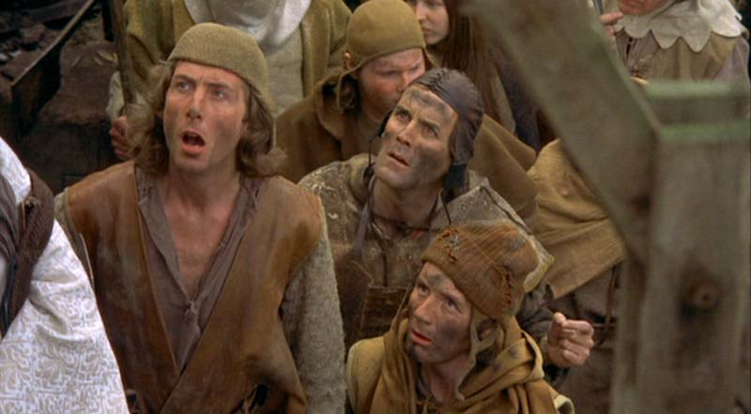
The Dark Ages?

Slide 3
Not So Dark!

Slide 4
Medieval Timeline: Significant Dates 451- 800 C.E.
400-500
Fall of Rome 476 (West divided into fiefdoms/tribal groups)
500-600
600-700
Muhammad establishes Islam as religion of Arabia, conquest of region starts soon after death in 632- most of Middle East under Islam by 642
700-800
Alaric’s conquest of Rome – 410
1st Holy Roman Emperor – Charlemagne (742-814) [essentially creating two Christian empires]
Birth of Muhammad (570)
Western (Benedictine) Monasticism begins with Rule of Benedict (525)
Constantinople as seat of Roman Empire begun by Constantine from 330 (now Istanbul)
Growth of monastic movement in Egypt/Syria/Palestine begun in 3rd c.
Rise of unique Byzantine Theology – deification as salvation (Athanasius)
Pope Leo III (717-742) –first Pope of united Christian empire (725-842)
Carolingian Renaissance: focus on life of the mind, establishment of universities
Gradual “Christianization” of Europe – monks as missionaries
Theological development of papacy
Monastic Orders promote education
Exacerbates divisions between Eastern & Western Christians

Slide 5
Medieval Timeline: Significant Dates 800 – 1453 C.E
1200- 1500
Development of scholastic theology (“cathedral of the mind”)
Age of great theological & spiritual writers/thinkers
Anselm of Canterbury
Peter Abelard
Thomas Aquinas
Julian of Norwich (female)
Catherine of Siena
Italian Renaissance & Humanism sets stage for Reformation & secularization
Fall of Constantinople – 1453
Church under Islam
Christendom in West

Slide 6
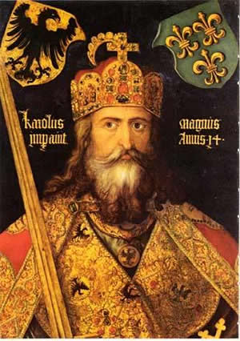
Critical Turning Point: Charlemagne (Charles the Great) 747-814
First Holy Roman Emperor

Slide 7
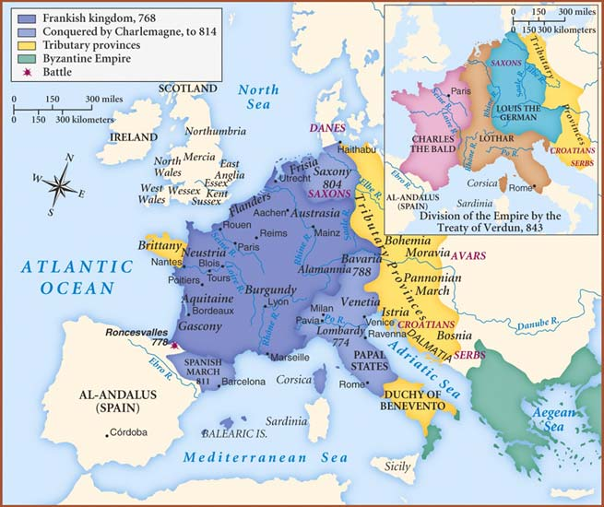
A New Map of Europe
The Treaty of Verdun, signed in August 843, was the first of the treaties that divided the Carolingian Empire into three kingdoms among the three surviving sons of Louis the Pious, the son and successor of Charlemagne. The treaty signed in Verdun-sur-Meuse ended the three-year Carolingian Civil War.

Slide 8
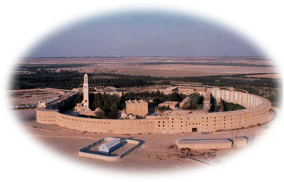
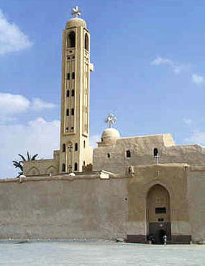
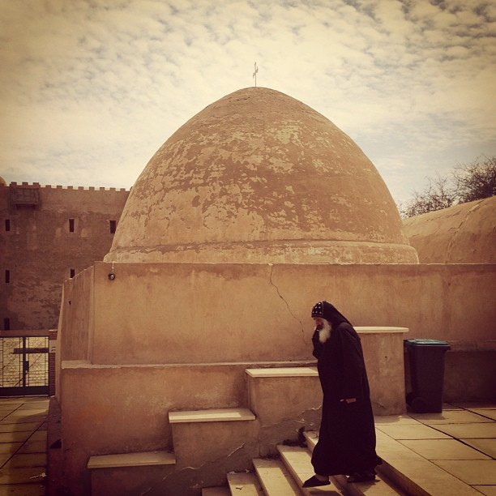
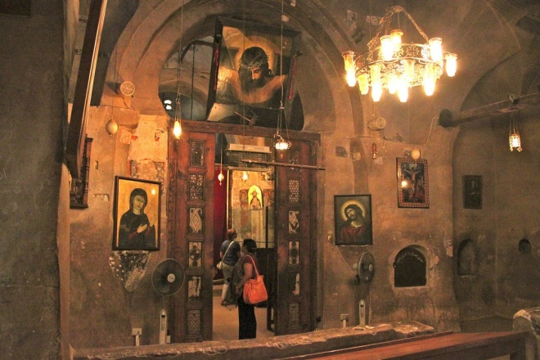
The Rise of Monasticism: Earliest Monasteries in Egypt
Oldest Continuously Occupied: St. Makarios

Slide 9
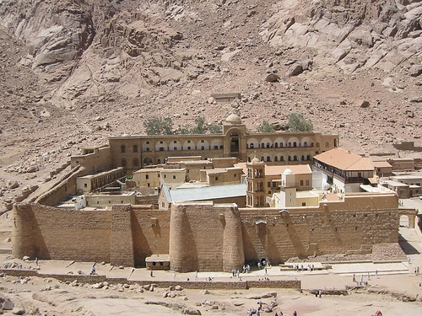
Where it Began: St. Anthony’s Monastery in the Egyptian Desert

Slide 10
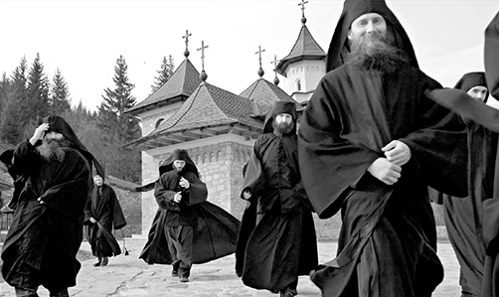
The Rise of Monasticism
Began in Egypt, parts of Syria in 3rd c.
Spread to Europe by 6th c.
Benedict of Nursia founds Benedictine Movement in 525
Important women mystics:
Hildegard of Bingen (1098-1179)
Mechthild of Magdeburg (1210-1282)
Catherine of Siena (1347-80)
Julian of Norwich (1342-1415)
Played critical role in development of theology during medieval period

Slide 11
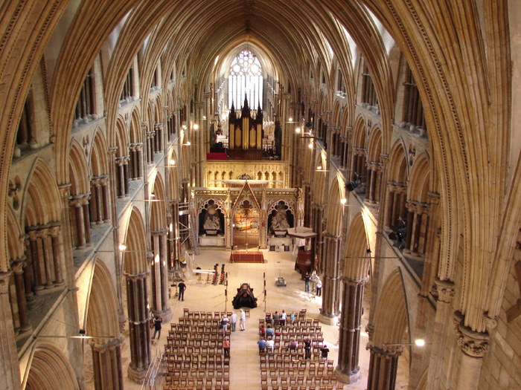
Monasticism in the West
Monasticism as protest & seats of learning
“Although the origin of the monasteries is to be traced back to the patristic era, they played a critical role in the development of theology during the medieval period.” (81)

Slide 12
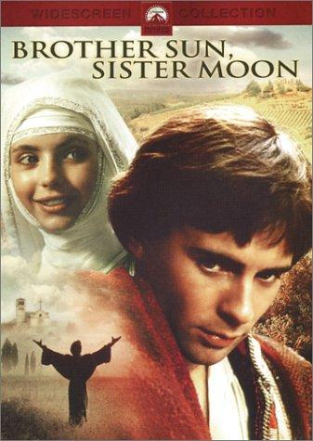
Brother Sun, Sister Moon: The Life of St. Francis

